Slide 1
Hive Query Tuning

Slide 2
Table of Contents
Background/Initial Findings
Recommendations
Query Performance – Stats
Best Practices
Telematics
Future State

Slide 3
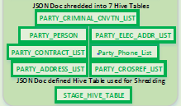
Background/Initial Findings:
Hive Queries
CDI
An Informatica job writes CDI JSON data, in a near real time (NRT) fashion, from MQ temporarily to the Informatica server. Another job writes the same to the landing zone on HDFS(Stage table) and to an archive area. Separate Hive jobs append/insert data into 7 detail tables sourcing data from the Stage table. Each of the Hive jobs/queries processes new records and addresses deleted records in separate queries which run through a few analytical operations by parsing the nested JSON data (extract the data and perform a left outer join on the previous run to capture incremental updates) before populating the tables. To replicate/simulate the prod environment, we obtained production data in “db1” database & performed various tests.
Ingestion:
Message Queue
Archive Area
(HDFS)
Staging Area
(HDFS)
Initial Observations:
No partitioning in Hive tables
Stats were not collected after data load
Memory & Hive/Tez settings were not optimized
Informatica job reads CDI JSON data from MQ
Another Informatica job picks up data and writes to HDFS
Writes temporarily to server
Informatica Server
Legend:
Informatica jobs run by
homegrown ANC scheduler

Slide 4
Recommendations:
CDI Queries
Changes Implemented
Table changes implemented: Tables were partitioned based on Date column as String data type Partition key was added in majority of queries Original Queries remain largely unchanged; Future scope – possibility to revisit queries to break them up into smaller chunks for facilitating trace and minimization of slowdowns due to the complex nature of the queries - to improve efficiency Hive & Tez memory parameters changed as below:

Slide 5
Query Performance - Stats
CDI Queries
Results
Below is a sample of a changed query: Section of Party_address_list select distinct a.doc.body.party.partyidentifier, a.doc.header.documentsequencenumber, cast(a.doc.header.eventdatetime as timestamp) as eventdatetime ……… from db1.a1_master_party_stg a inner join db1.a1_party_address_crrnt_v p on a.doc.body.party.partyidentifier = p.id and p.eventdate= TO_DATE(a.doc.header.eventdatetime) left outer join db1.a2_dte_part_party_person pp on pp.eventdate= TO_DATE(a.doc.header.eventdatetime) and pp.id = cast(a.doc.body.party.partyidentifier as bigint) and pp.documentsequencenumber = a.doc.header.documentsequencenumber where cast(a.doc.body.party.partyidentifier as bigint) is not null and TO_DATE(a.doc.header.eventdatetime)='2017-02-02' and pp.id is null Below are the stats from the execution of each query after making recommended changes to the existing Delete scripts.

Slide 6
Best Practices:
Hive Query
Best Practices
Below are Best Practices to run Hive queries. These are all implemented in test environment. Partition Hive Tables as possible. It is a way to improve query performance on large tables by limiting the amount of data to be read by the query Avoid functions in Join criteria - the function value has to be evaluated for each row of data to determine if it matches the criteria, so table-scans on large datasets would be costly. Use Tez as the processing engine for faster processing set hive.execution.engine=tez Use Vectorization. Helps in processing rows in batches instead of a single row set hive.vectorized.execution.enabled = true; set hive.vectorized.execution.reduce.enabled = true; Analyze tables before running hive query especially after loading large amount of data. ANALYZE TABLE Table1 PARTITION(ds, hr) COMPUTE STATISTICS; Use Cost Based Optimizer to compare cost functions of optimizers and choose the right one for the current scenario set hive.cbo.enable=true; - Applies to ORC formatted data set hive.compute.query.using.stats=true; set hive.stats.fetch.column.stats=true; set hive.stats.fetch.partition.stats=true;

Slide 7
Telematics:
Hive Performance
Telematics Query issues:
Telematics query runs had a few issues. One of the issues was that the query was throwing a Java runtime error. This was due to a bug associated with HDP 2.3.4(which is currently in use). This was subsequently fixed starting with HDP 2.4.2 onwards. There is, however, a workaround for this error in the current code - by passing the parameter ”SET hive.fetch.task.conversion=none” the query completes execution without any Java error in 6 - 7 minutes. The view which sits on top also works and the query gets executed in 8 - 9 minutes (select * telematics_v where point_dt=’2017-04-01’). The second issue was that there were too many small part files being created after a query run. The solution was to merge them into a larger file and insert into another file. As of this publishing, that is still a WIP.

Slide 8
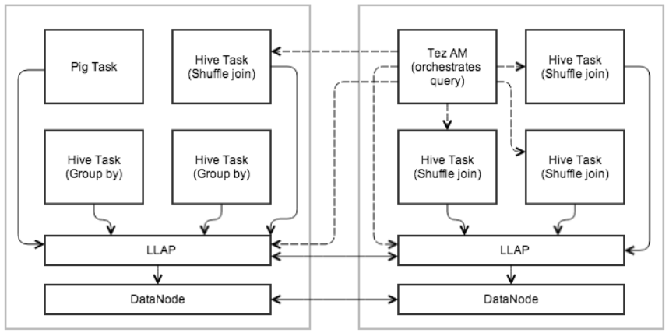
Future State:
Hive Performance
Future State/Next Steps
Query engine in Hadoop is evolving rapidly and getting better. Initial implementation was done based on MapReduce. Currently Tez is the preferred engine. As the next steps, consider Spark SQL as query processor as much as possible. Spark can help to execute SQL queries in memory on distributed data sets persisted in HDFS for faster processing. SparkSql supports Hive data formats. The Hive metastore is used to get the metadata of the data stored. LLAP(Low Latency Analytical Processing) - This is next generation query engine and is available in HDP 2.6. One click enablement in Ambari makes for easy LLAP implementation. Tez execution with LLAP
Further reading - https://hortonworks.com/blog/top-5-performance-boosters-with-apache-hive-llap

Slide 9
Hive Query Tuning
Findings
CDI queries were written well but were taking longer time finish
Major Hive tables were not partitioned
Stats were not collected after major data loads
Hive/Tez/YARN Settings were not optimized
Actions taken
Delivery tables were partitioned based on evet date and Partition column was incorporated in the queries
Original queries remain largely unchanged – only portions changed for tuning were in the delete sub-queries
Tables were analyzed and Cost Based Optimizer was enabled
Hive/Tez/YARN parameters including few runtime parameters were tuned
Query performance was recorded after implementation of the above changes
Improvements
Performance improvements from above changes reflected in below:
Table Names | Tuned Query Time(% improved)
Party_cross_ref | 13%
Party_address_list_Update | 40%
Party_criminal_contract | 15%
Party_contract_list | 27%
Party_elec_address_list_Update | 52%
Party_person | 29%
Party_phone_list | 6%

